Slide 1
AQA
A Level
Computer Science
Paper 1
Optimisation algorithms
Unit 8
Algorithms

Slide 2
Shortest path problems
When you send an email, log in to your school computer from home or search the Internet, a lot happens behind the scenes
The IP-router has to determine which is the best and fastest way to send your message
Finding the shortest path has applications in circuit board design, route planning, games strategy and project management, for example

Slide 3
Dijkstra’s shortest path algorithm
The algorithm is designed to find the shortest path between a start node and every other node in a weighted graph
The weights could represent, for example, distances, time or cost of travel between cities

Slide 4
Implementing the algorithm
The implementation of the algorithm is similar to a breadth first search
It uses a priority queue as the supporting data structure to keep a record of which vertex to visit next
It starts by assigning a temporary distance value to each node
The temporary distance is 0 at the start node, and ∞ at every other node

Slide 5
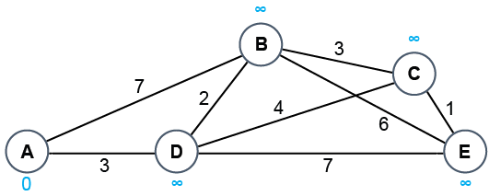
Starting the algorithm – Step 1
A = 0 | B = ∞ | C = ∞ | D = ∞ | E = ∞
All the nodes are in the priority queue
All nodes are coloured white to show they have not been visited
Temporary distances are marked at each node

Slide 6
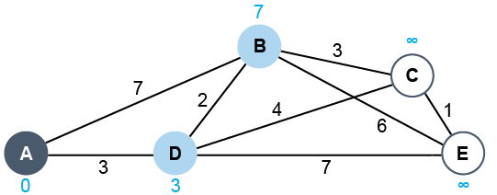
Step 2
D = 3 | B = 7 | C = ∞ | E = ∞
Remove A from the queue and shade it dark blue
Shade A’s neighbours pale blue
Add A’s distance value (0) to edge weights between A and B, A and D
Move D and B to the front of the priority queue

Slide 7
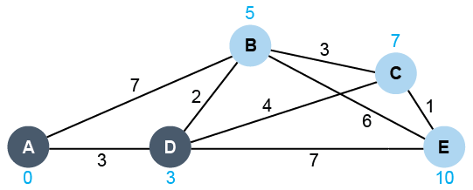
Step 3
B = 5 | C = 7 | E = 10
Remove D from the queue and shade it dark blue
Shade unvisited neighbours of D pale blue
Calculate new values for neighbours of D

Slide 8
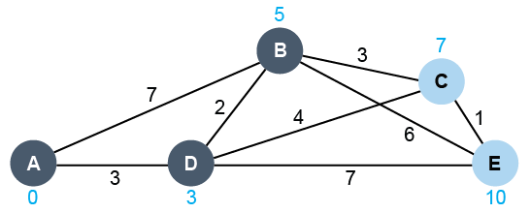
Step 4
C = 7 | E = 10
Remove B from the queue and shade it dark blue
Calculate new values for neighbours of B; both these are greater than current values, so nothing changes

Slide 9
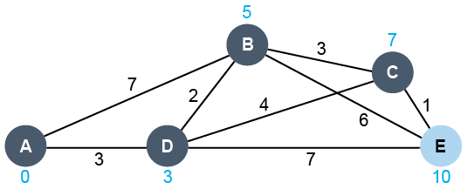
Step 5
E = 10
Remove C from the queue and shade it dark blue
Recalculate values for neighbours of C; E = 7 + 1 = 8

Slide 10
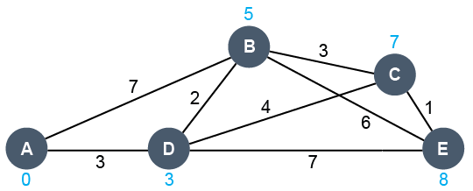
Step 6
Remove E from the queue and shade it dark blue
The queue is now empty and the algorithm has completed
Minimum distances from A to every other node are shown

Slide 11
Worksheets
Complete the questions in Worksheets 1 & 2

Slide 12
Plenary
What is the purpose of Dijkstra’s algorithm?
What is the supporting data structure used in one implementation of the algorithm?
What is the main feature of this data structure?
Name three applications of Dijkstra’s algorithm

Slide 13
Plenary
Dijkstra’s algorithm is designed to find the shortest path between a starting node and every other node in a weighted graph
The supporting data structure used in one implementation of the algorithm is a priority queue
Items in a priority queue are held in order of priority
Applications of Dijkstra’s algorithm include:
finding the shortest/cheapest route over the Internet
planning circuit boards
finding shortest route between cities

